Slide 1
Creativity in Coaching Art in Action
Jenny Bird
&
Sarah Gornall

Slide 2
Why pictures help to create clarity
Findings of Neuroscience

Slide 4
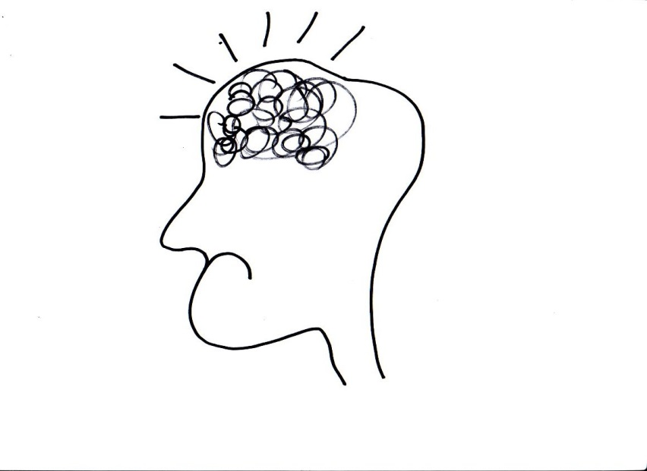

Slide 5
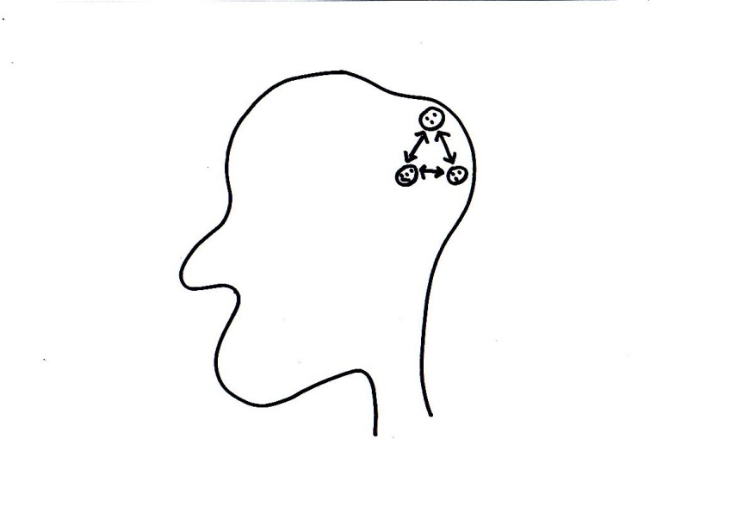

Slide 6
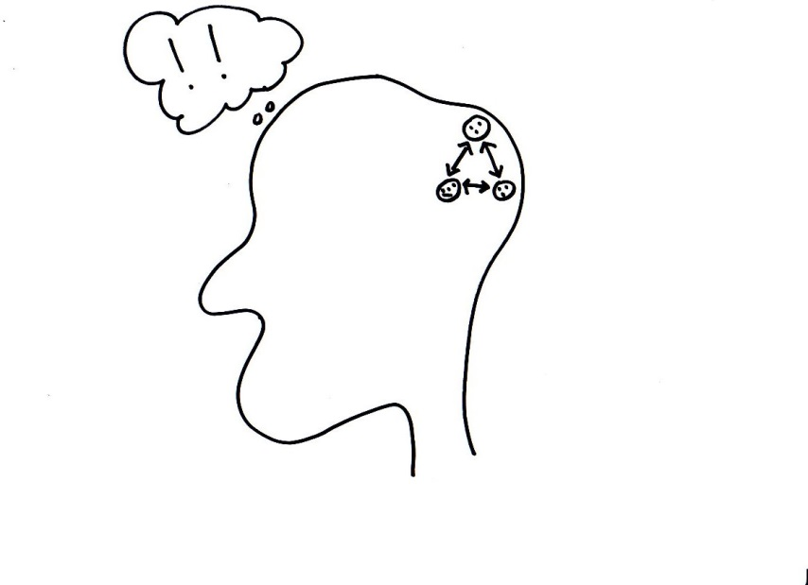

Slide 7
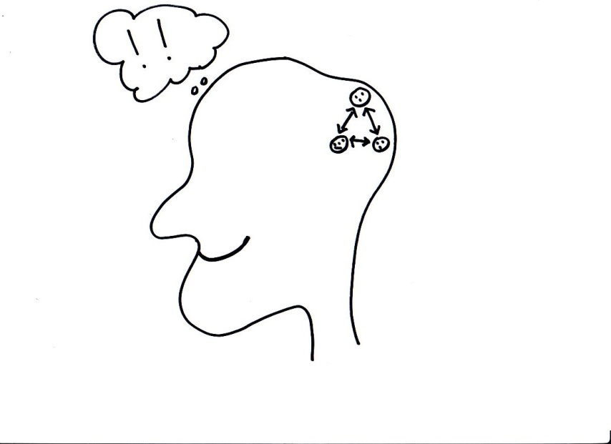

Slide 8
Making meaning in Coaching
Sitting alongside the client to get a new view on the context

Slide 10
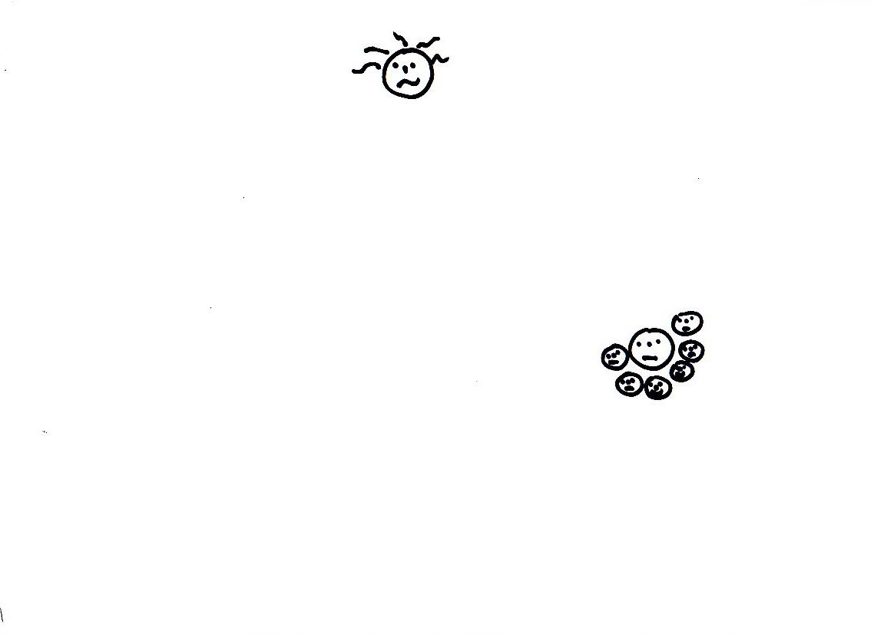

Slide 11
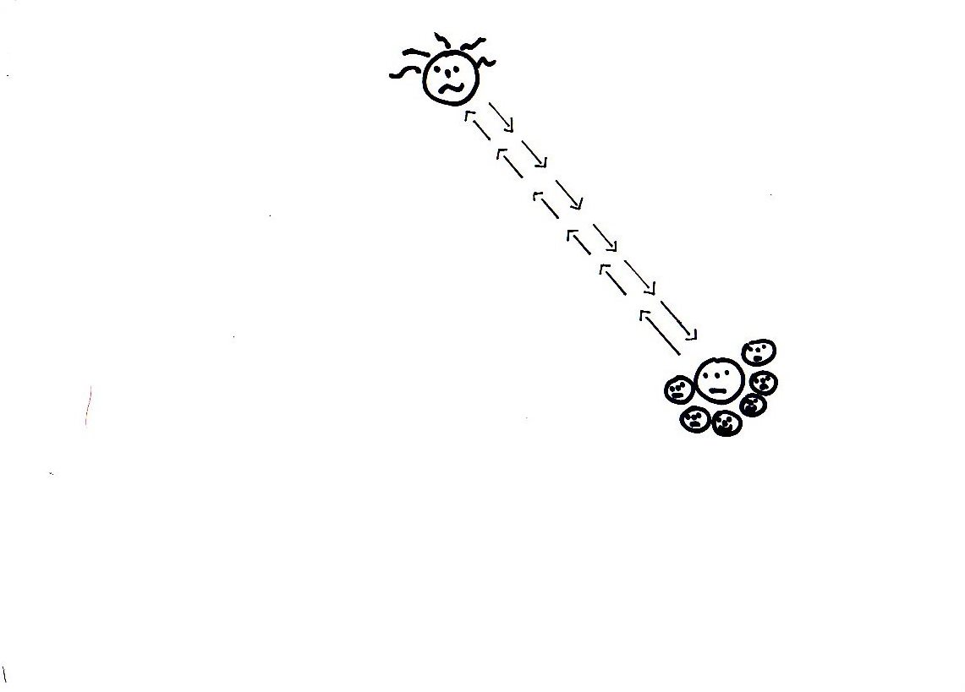

Slide 12
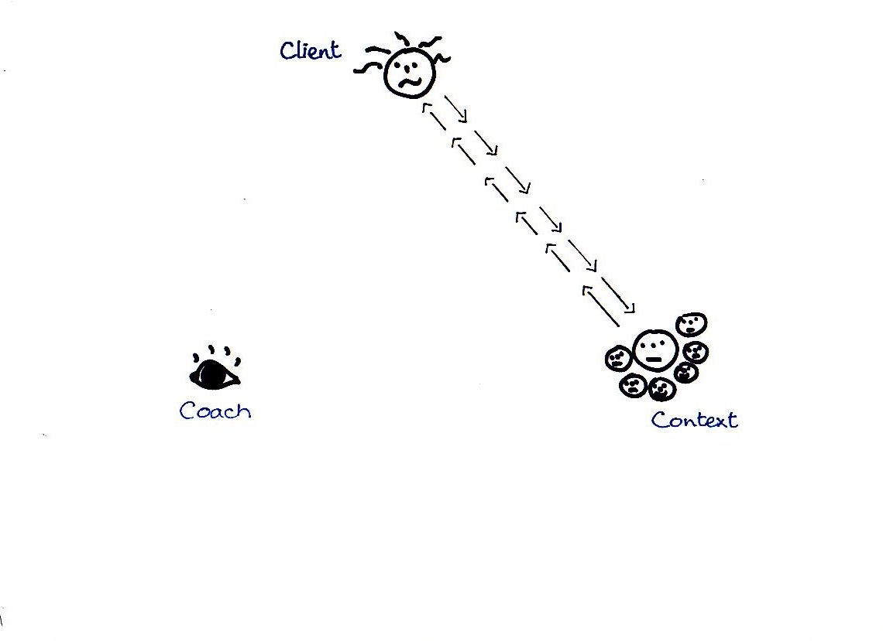

Slide 14
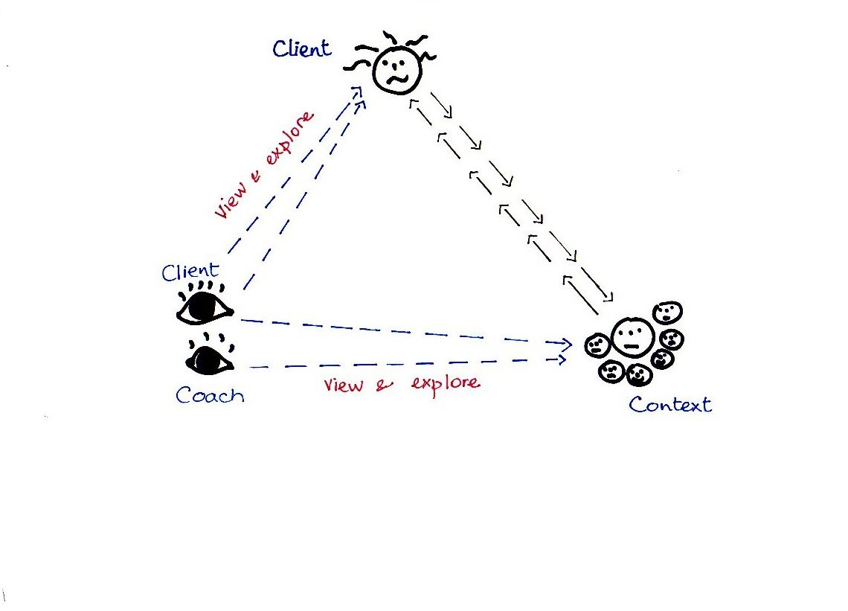

Slide 15
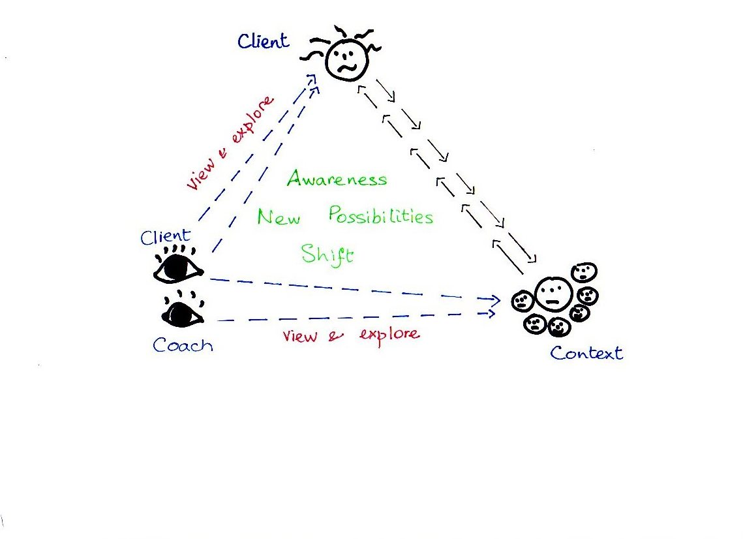

Slide 16
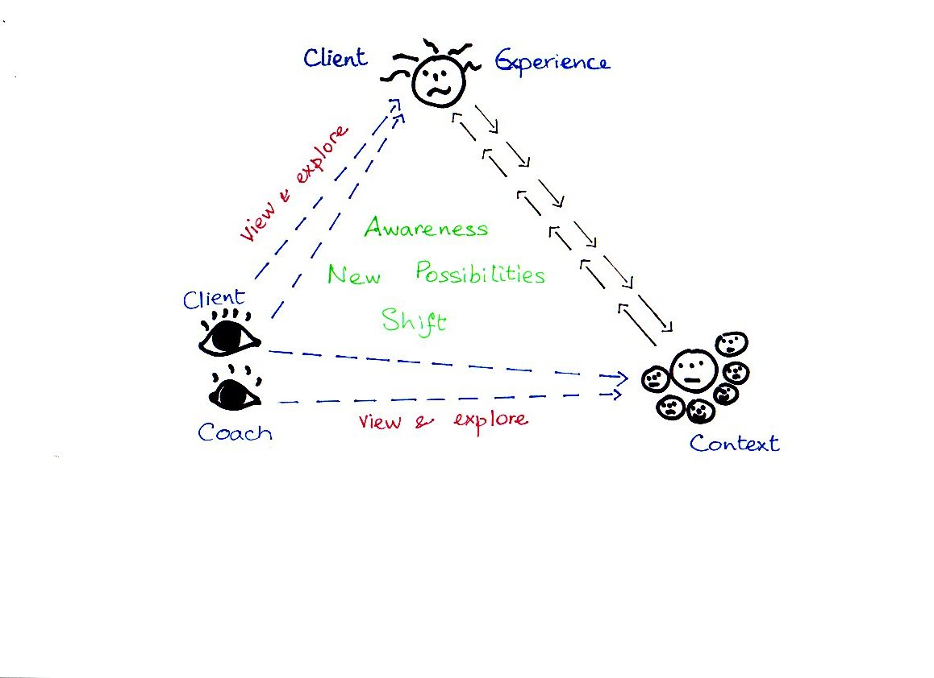

Slide 17
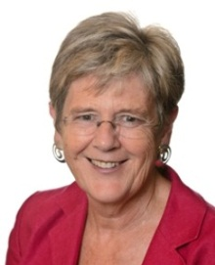
Contact details
jenny@coachsupervisor.co.uk
07816 262 536
sarah.gornall@coachingclimate.co.uk
07799 103 205

